Slide 1
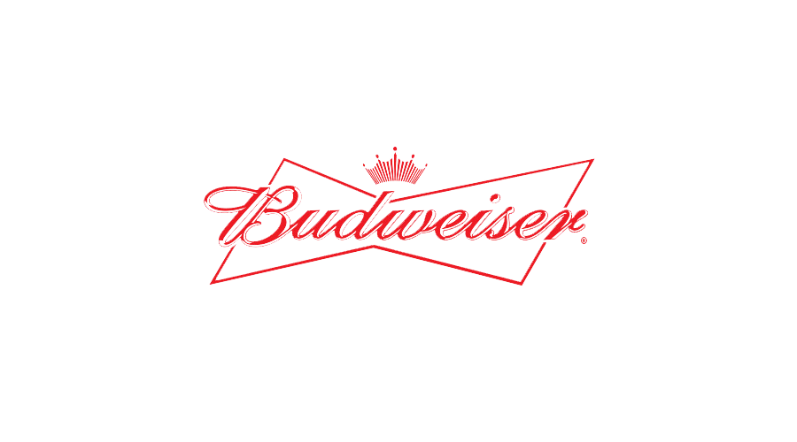


Beer & Breweries
Case Study
Prepared by:
Erika Dupond, Victoria Hernandez, Waleed Amer

Slide 2
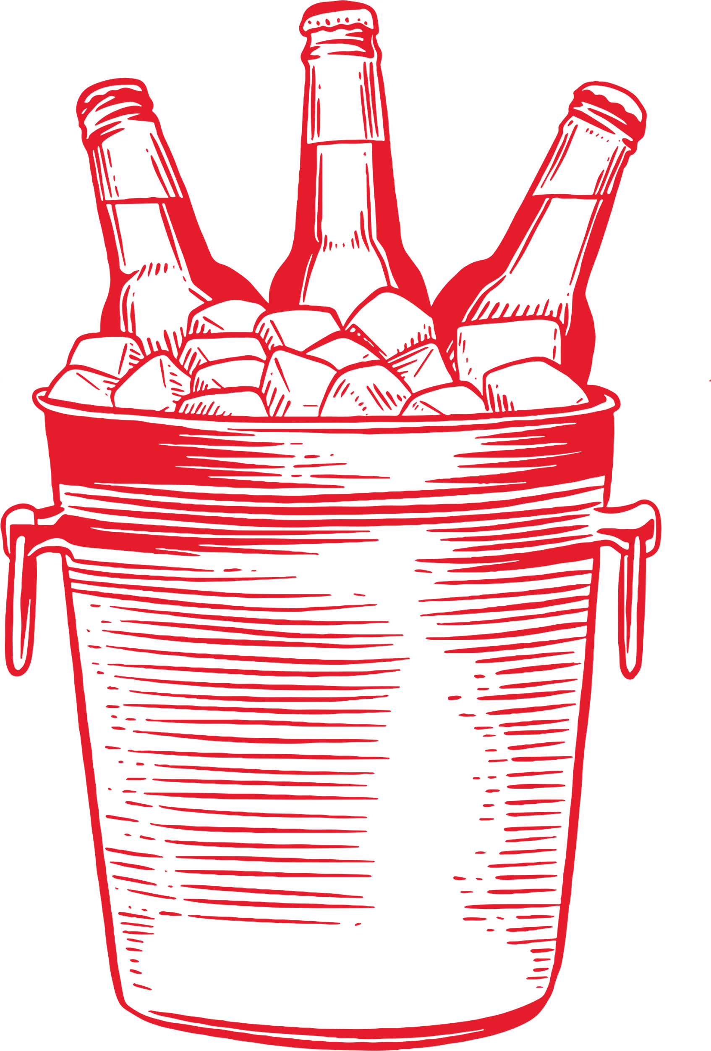
Agenda
Introduction
Distribution of Breweries across the United States
Median ABV and IBU across states
Max ABV and IBU across states
Address Missing Values
Summary statistics
Relationship between IBU and ABV
Beer Market Segmentation

Slide 3

Introduction
Our two data sets:
Beer: 2,410 U.S. craft beers,
alcohol by volume (ABV)
International Bitterness Units (IBUs),
Beer style
Breweries: 558 U.S. breweries,
location and size
Goal in Analyzing and Cross Referencing these data sets
Notes:
We have undertaken a comprehensive analysis of two important datasets that provide a detailed snapshot of the brewing industry. The first dataset encapsulates a wealth of information on 2,410 U.S. craft beers, covering aspects such as their alcohol by volume (ABV), International Bitterness Units (IBUs), and beer style. This data offers valuable insights into the popularity of various beer styles, the correlation between ABV and IBUs, and potential market trends.
The second dataset provides records on 558 U.S. breweries, including their location and size. This dataset will allow us to understand geographical distribution, market saturation, and opportunities for expansion. By cross-referencing these datasets, we can identify patterns and trends that could inform Budweiser's strategic decisions.
Our goal is to present these findings in a clear and impactful manner, focusing on the implications of the data rather than the technicalities of the analysis. We trust that these insights will contribute significantly to shaping Budweiser's future strategies. Thank you for your time, and we look forward to discussing our findings with you.

Slide 4
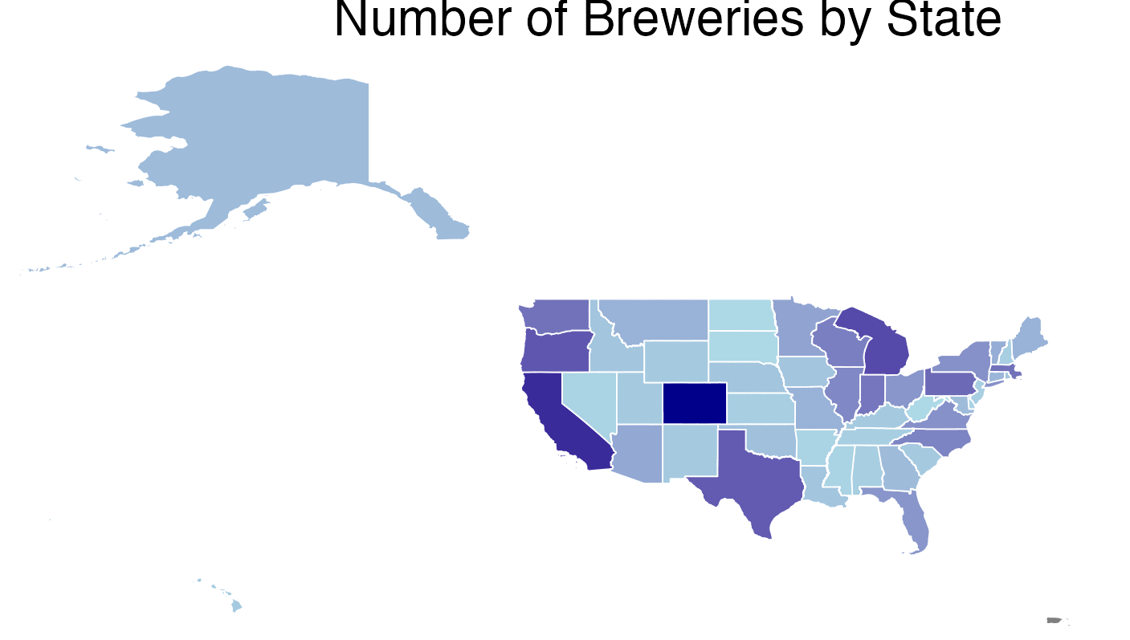
How many breweries are present in each state?
Most Breweries
Colorado 47 California 39 Michigan 32
Least Breweries
North Dakota 1
South Dakota 1
West Virginia 1

Slide 5
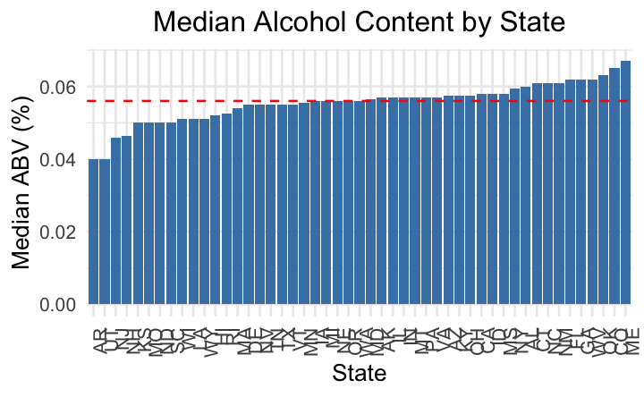
Max ABV: 0.128 Minimum ABV: 0.001 Median ABV: 0.056

Slide 6
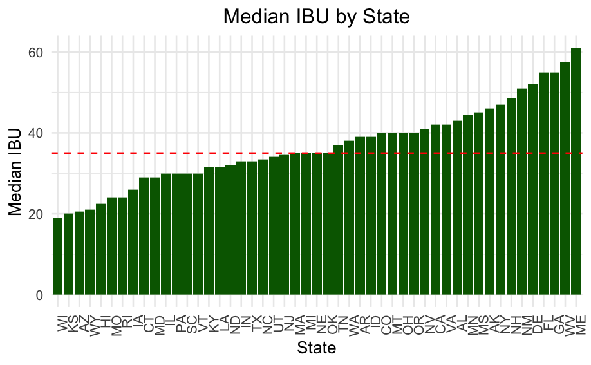
Max IBU: 138 Minimum IBU: 4 Median IBU: 35

Slide 7
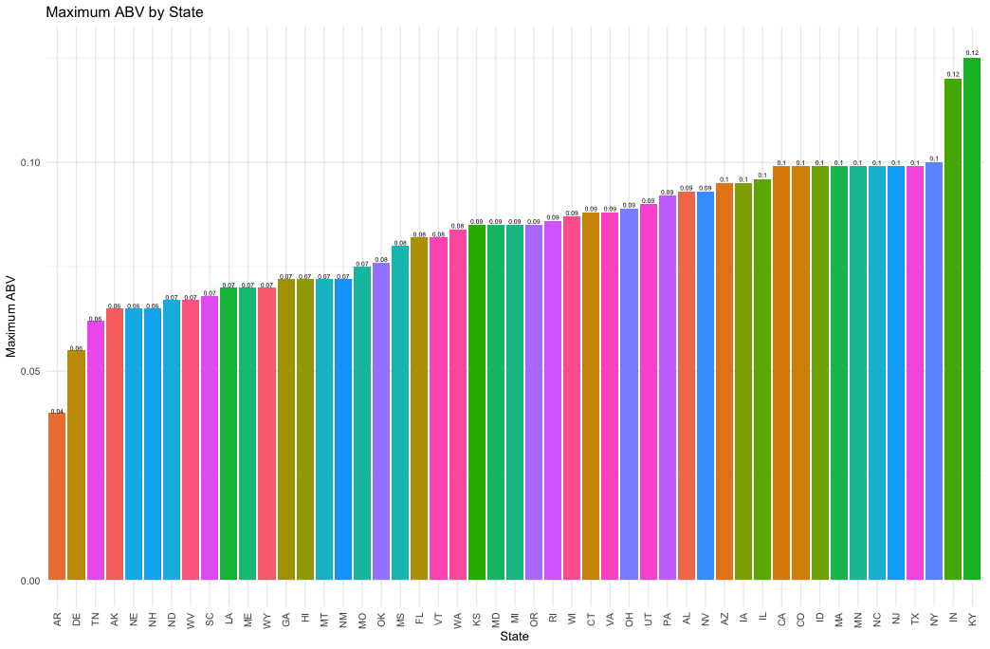
Which state has the maximum alcoholic (ABV) beer?
The state with highest ABV is Kentucky followed by Indiana.

Slide 8
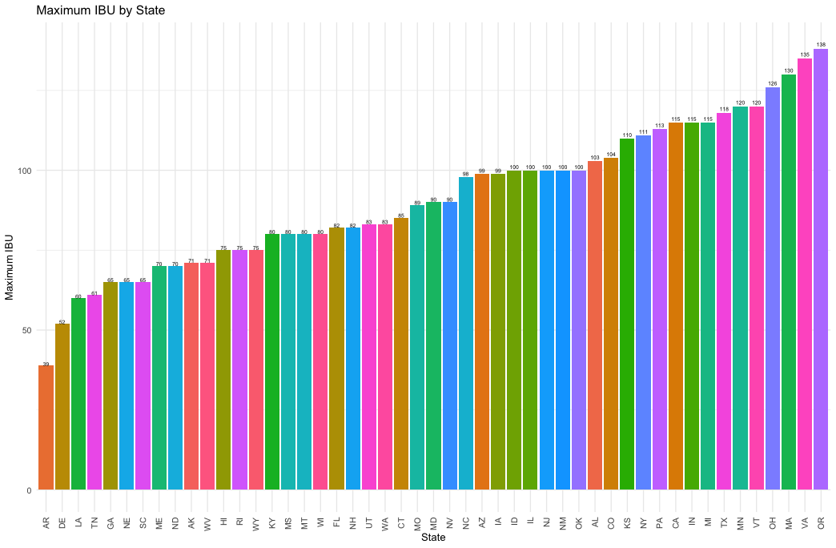
Which state has the most bitter (IBU) beer?
Oregon has the highest IBU and is followed by Virgina.

Slide 9
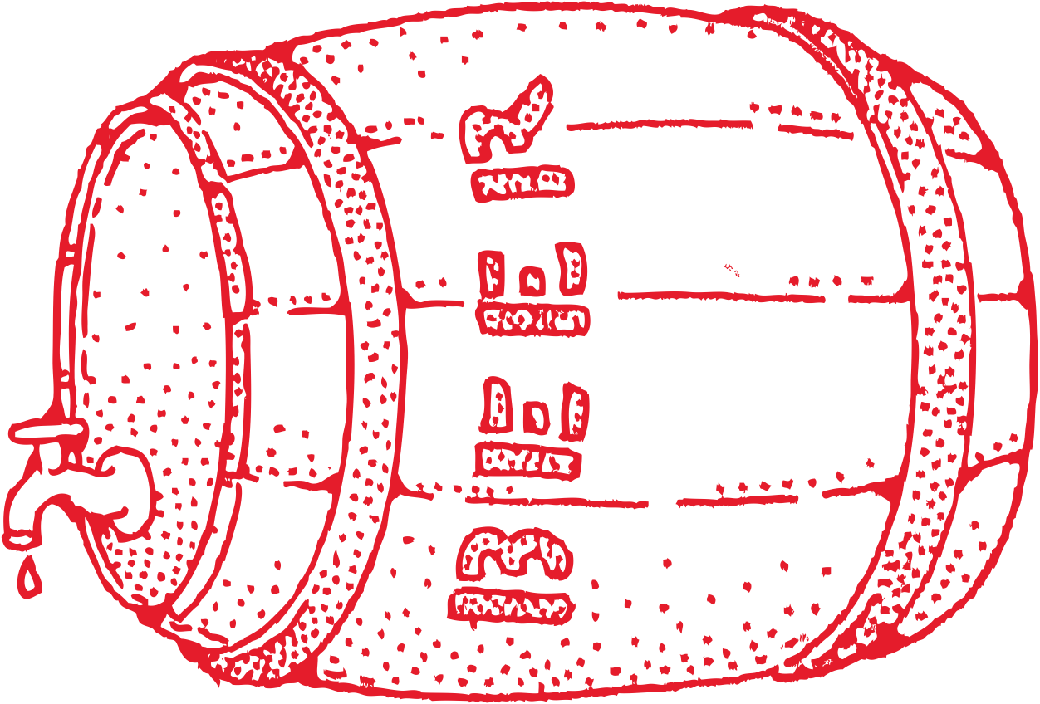
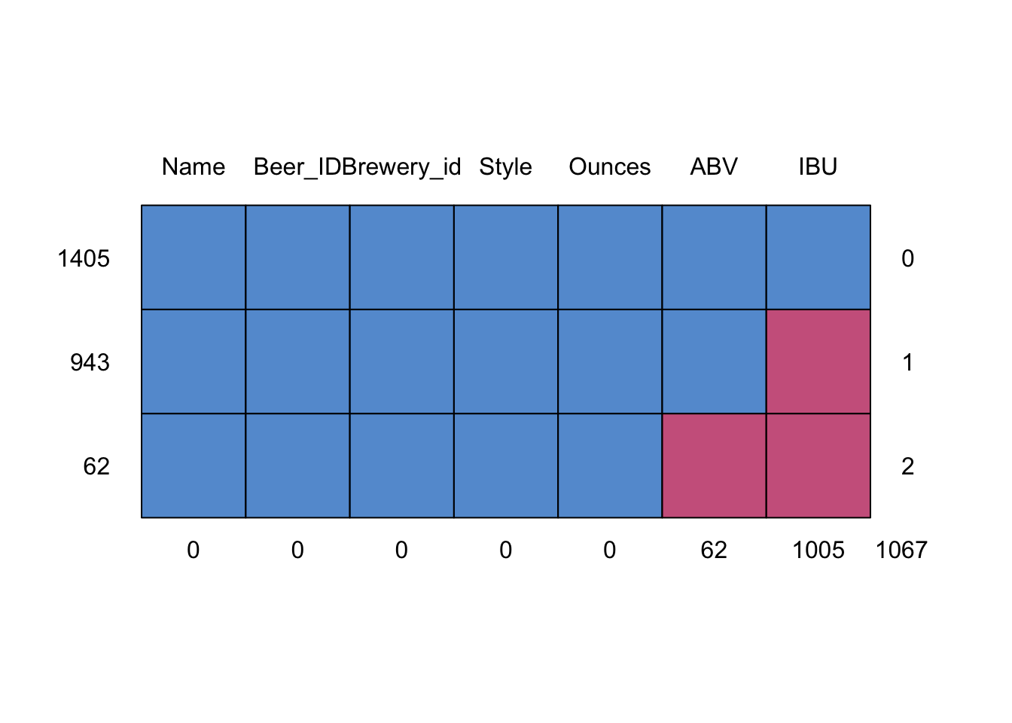
Summary statistics, distribution of the ABV variable and missing values
ABV Range and Distribution
IBU insights
Regional Preferences
Kentucky
Oregon
Missing Values and Handling them
Implications
Limitations
Notes:
ABV Range and Distribution: The ABV in the dataset ranges from a low of 0.1% to a high of 12.8%, with the bulk of beers clustered around 5.6%. The average ABV is slightly higher at 5.98%, indicating the presence of beers with significantly higher alcohol content that skew the average upwards.
IBU Insights: The median IBU is 35, suggesting that half of the beers have a bitterness level below this value and half above. However, the mean IBU is 42.71, which indicates that there are beers with considerably high bitterness levels that affect the average, making it higher than the median.
Regional Highlights: Kentucky is noted for producing the beer with the highest ABV, suggesting a preference or specialty for stronger beers in that state. Oregon is highlighted for having the most bitter beer, pointing to a regional preference or expertise in brewing bitter beers.
Data Integrity and Handling: The analysis responsibly handled missing data, with 62 instances of unrecorded ABV excluded. This approach ensures that the insights derived are based on reliable and complete data points. The missing ABV values could be missing if the brewery did not or chose not to measure ABV values for some beers and there does not seem to be certain types of beer more likely to be missing ABV so these are missing at random. The large number of missing IBU values could suggest measuring IBU is too expensive or time consuming so breweries would choose not to measure this leaving the values missing at random. We used MCAR test to create a heat map of the data missingness to determine patterns.
Implications for Marketing and Strategy: These insights are valuable for understanding consumer preferences and regional specialties, which can inform marketing strategies, product development, and targeting. Knowing that certain regions have a preference for or produce significantly stronger or more bitter beers can help breweries tailor their products and marketing efforts to meet local tastes.
Dataset Limitations: It's important to recognize that these findings are based on the current dataset and may not comprehensively represent all beers. The dataset's scope and the handling of missing data points can influence the insights derived.
In summary, this analysis provides a detailed view of the alcohol content and bitterness levels in beers, highlighting regional specialties and preferences, and underscoring the importance of data integrity in deriving meaningful insights.

Slide 10

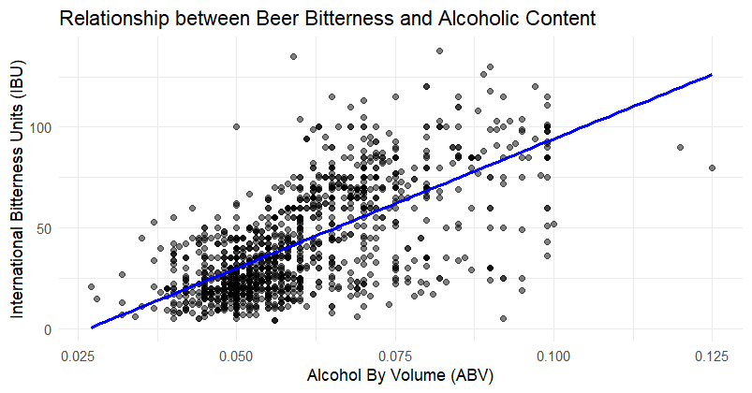
Relationship between IBU and ABV
ABV increases and IBU does as well GENERALLY
Variability
Concentration of Data points
Outliers
Notes:
The scatter plot with a linear model fit illustrates the relationship between the beer's bitterness (IBU) and its alcoholic content (ABV). Here are the key points observed from the plot:
Positive Correlation: There appears to be a positive correlation between ABV and IBU. This means that, generally, as the alcoholic content of the beer increases, its bitterness tends to increase as well. The slope of the linear model fit (the blue line) is positive, which supports this observation.
Variability: While there's a general trend, there's also considerable variability around the line. This suggests that, although a higher ABV is often associated with higher IBU, this relationship is not strictly linear for all beers. Various factors such as beer style, brewing process, and ingredient choices can affect the IBU independently of the ABV.
Concentration of Data Points: Most data points are clustered in the lower range of both ABV and IBU, indicating that a majority of beers have moderate alcohol content and bitterness levels. However, there are beers with high ABV and correspondingly high IBU, although these are less common.
Outliers: There are outliers in the plot, especially beers with high IBU but moderate ABV, and vice versa. These outliers highlight the diversity in brewing styles and preferences, where some beers are formulated to be exceptionally bitter or alcoholic without necessarily correlating strongly with the other characteristic.
In summary, the scatter plot suggests a general trend where beers with higher alcoholic content tend to be more bitter, yet the relationship is influenced by a wide range of factors, resulting in variability. This analysis underscores the complexity of beer brewing and formulation, where brewers balance various elements to achieve desired flavors and characteristics.

Slide 11
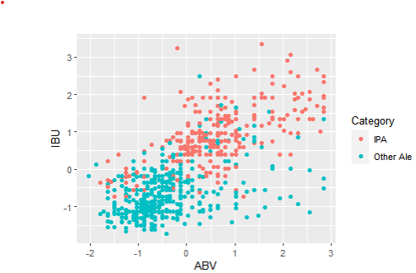
Difference between IPA and Other Ale types with respect to ABV and IBU levels.
Comparison of IPA and Other Ale types by cross-validating using the ABV and IBU levels
Using K-Nearest Neighbors (KNN) classification method,
62 true positives for "IPA" categories and 99 true positives as "Other Ale" categories
accuracy percentage: 83.4%
Predicted
 | IPA | Other Ale
IPA | 62 | 14
Other Ale | 18 | 99
Actual

Slide 12
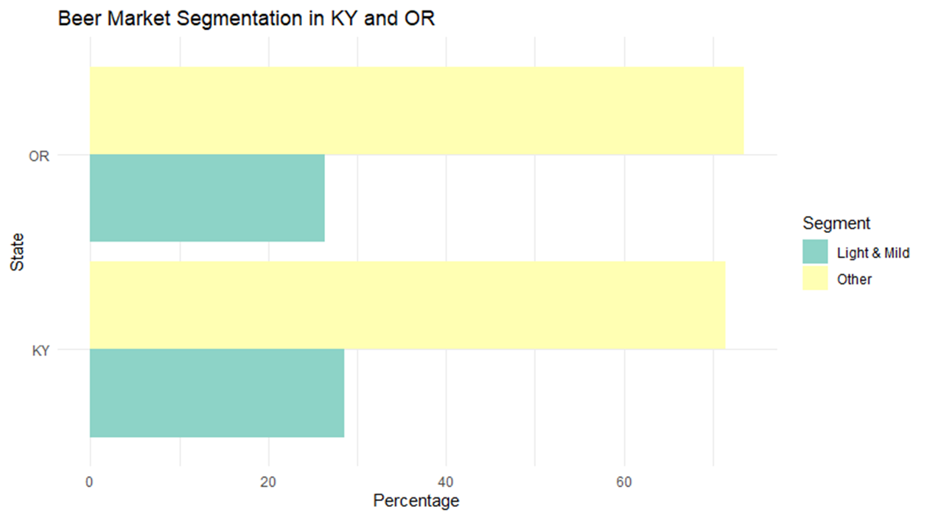
Beer Market Segmentation Between States
Beer Preferences
Craft Beet Market Growth
Domestic Beer Consumption
Future Market Projections
Strategic Implications
Notes:
From the data we have analyzed, we find that in Kentucky (KY), 28.6% of beers fall into the "Light & Mild" category, while a significant 71.4% are placed in the "Other" category. In Oregon (OR), the distribution is somewhat similar with 26.4% being "Light & Mild" and a substantial 73.6% categorized as "Other". This provides evidence of a potential preference for beers with higher ABV and IBU in these states, as the "Other" category likely encompasses "Standard & Balanced" and "Strong & Bitter" segments.
This trend aligns with broader market dynamics. The craft beer segment, known for its unique and often locally-inspired flavors, has seen considerable growth, now accounting for 24.6% of the $115 billion U.S. beer market¹. Meanwhile, domestic beers, including Budweiser, made up around 69% of U.S. beer consumption in 2022². However, the total beer volume in the U.S. experienced a negative compound annual growth rate (CAGR) of 2% between 2017 and 2022³.
The combination of these trends suggests a shifting landscape where consumers are increasingly attracted to craft beers. Thus, Budweiser's investment in local brands within KY and OR could be a strategic move to tap into this burgeoning market segment.
Looking towards the future, projections indicate an upward trajectory for the beer market. The U.S. beer market is forecasted to grow by 1.98% from 2024 to 2028⁴, and the North American beer market is expected to reach USD 214 billion by 2029, growing at a CAGR of 4.39%⁵.
Drawing from these statistics and their implications, the evidence would suggest that Budweiser stands to gain by investing in local brands in states such as KY and OR. This approach would not only allow Budweiser to diversify its product portfolio but also position the brand to capitalize on the growing demand for more varied and locally-inspired flavors. In doing so, Budweiser could potentially increase its market share in the evolving U.S. beer industry.

Slide 13
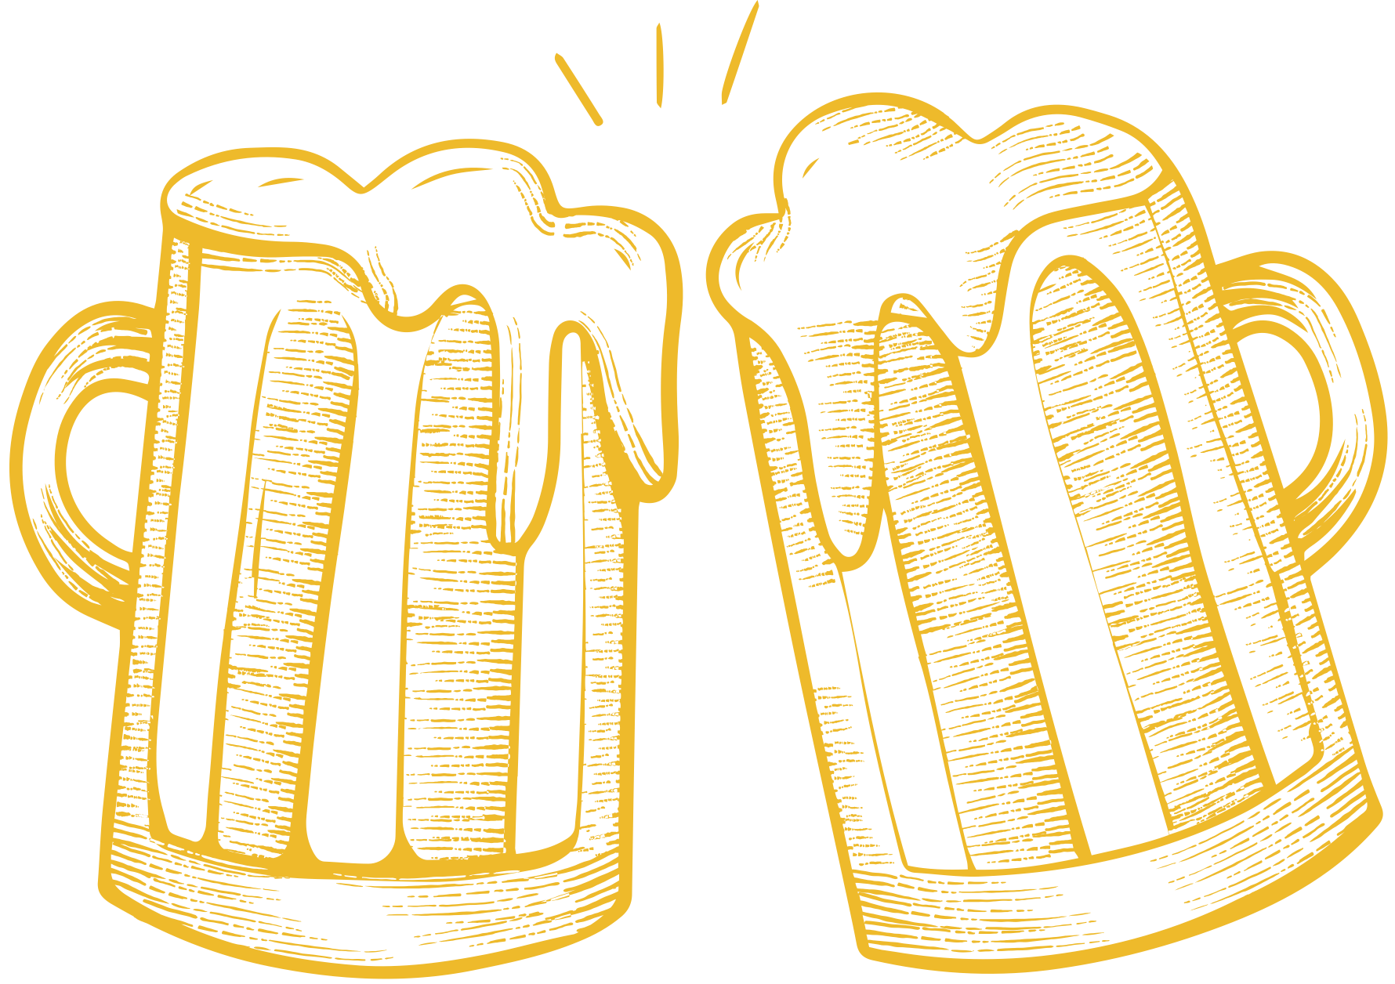
Thank You!
We may take your questions now

Slide 14
For reference to the data and project, please visit:
GitHub - torih1541/Case-Study-1-DDS: Craft Beer and Brewery Analysis for Budweiser
Footnotes
https://www.brewersassociation.org/statistics-and-data/national-beer-stats/
https://www.statista.com/topics/1654/beer-industry-in-the-united-states/
https://www.theiwsr.com/key-trends-for-the-us-beer-market-in-2023/
https://www.statista.com/outlook/cmo/alcoholic-drinks/beer/united-states
https://www.mordorintelligence.com/industry-reports/north-america-beer-market

